Slide 1

Science
Notes:
MANKIND IS INTERESTED IN UNDERSTANDING THE WORLD AROUND IT.
There are many explanations offered for natural phenomena
· Some are “revealed truths” of a religious nature
· Some are more philosophical. e.g. The ancient Greeks saw matter as composed of four elements, air, earth, fire, and water.
· “Science” is an organized way of investigating the world; it is imagination focused by the reality of experiments on the world around us.
The heart of science is a belief in rules and laws of nature; these rules can be uncovered objectively using the SCIENTIFIC METHOD.
· The method often begins with an observation.
· The observation may elicit an hypothesis (understanding) about the underlying rule of nature.
· Controlled experiments are carried out to elucidate the (mathematical) form of the natural rule. The work is PUBLIC and REPRODUCIBLE. A simple example is the solubility of a solute with temperature (right).
· Some science is, of necessity, observational—like astronomy
Many experiments may give rise to a LAW of nature. These are usually excellent approximations to natural phenomena. An example is the law of mass action or the conservation of mass in ordinary chemical reactions.
A THEORY of science is a MODEL of a portion of the natural world which includes all known laws and experimental results. The best models, or theories, make predictions about the world which can be experimentally tested to assure the power of the current theory. A famous example is the discovery of the positron.
· In chemistry a famous theory is the Atomic Theory which describes matter as composed of atoms. These have nuclei of protons and neutrons, and electron filled shells which account for chemical and some physical properties. This theory works very well and makes the air, earth, fire, and water model seem quite crude.
· In physics the Theory of Relativity explains the behavior of matter and energy in space-time. This astonishing “4D” model can be shown to be more correct than any 3D model.
In biology the Theory of Evolution explains the nature of speciation and also rationalizes molecular structures which will be examined in Biochemistry.
Science is not revealed truth but is the results of work by trained men and women, like us, working through the scientific method. Most experimental details are correct, within experimental error, and interpretations are rigorously reviewed and likely to be basically correct. Future work will modify these interpretations as new information emerges—change is often then REVOLUTIONARY.
Science does a great job of explaining the world around us and allowing us to control large parts of it. It does not address issues of morality, politics, or esthetics. Religion, philosophy, the arts or therapy may be needed for guidance in these areas.

Slide 2
The Functions of Science
pure science applied science
the search for
knowledge; facts
using knowledge
in a practical way

Slide 3
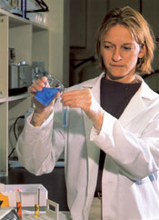
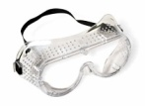
Pure Science
?
The search for facts about the natural world.
  In science, we often try to establish a cause-effect
  relationship.
  Driven by curiosity: the need to know, explore,
  conquer something new.
Notes:
Pure science is often what is done at universities and colleges. The basic understanding of why and how things work and react as they do are discovered. The goal in pure science is NOT to make money – but to understand. Industry often funds research at universities in hopes of taking what is learned to make a marketable product and to make money. This synergistic relationship between the business community and academia is beneficial to both parties.

Slide 4

Applied Science
The practical application of scientific discoveries.
  Also known as
  “technology”
  - Used to improve our lives
    Cell phones
    Biodegradable garbage bags
Notes:
APPLIED SCIENCE
With all technology, science has a moral component.
What are some pros and cons of our present-day technology?
great potential for good…great risk for harm.
Technology is a mixed blessing. Must weigh the potential good vs. harm of technology.
e.g. Atomic bomb may save human lives.
What we search for and how we use technology depend on out system of values.
e.g. Human cloning to harvest organs for transplantation.
Stem cell research.

Slide 5

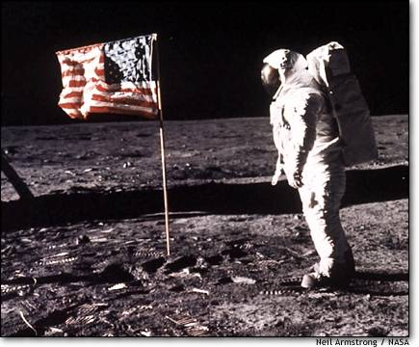
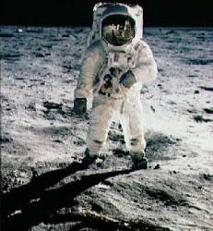

Corning Glass
NASA’s Problem
Design a material
that is clear and can with-
stand extreme differences
in temperature without fail-
ing (cracking).
Corning Glass
FAILED…but
SUCCEEDED at making
great cookware that can
withstand extremes in temperature.
Design a face shield
to protect and provide
clear vision.
Notes:
Often times in science, great discoveries are made serendipitously or by accident. People set out with a goal in mind and discover something else, quite remarkably.

Slide 6
How does scientific knowledge advance?
1. curiosity
2. good observations
3. determination
4. persistence
Notes:
Fleming: biologist knew that bacteria was on everything. Was curious about a moldy orange in his lab. Made a microscope slide and noticed that no bacteria was on the mold.
His CURIOSITY helped him to discover penicillin.
Charles Martin Hall - was determined to find a method to extract aluminum from the ore bauxite that was readily available in Earth's crust. He succeeded!

Slide 7
The Scientific Method
Notes:
Robert Boyle
Published The Sceptical Chymist (1661)
…stated that scientific speculation was worthless unless it was supported by experimental evidence.
This principle led to the development of the scientific method.

Slide 8
Using the scientific method requires that one be a good observer.
observation inference
uses the five
senses
involves a judgment
or assumption

Slide 9
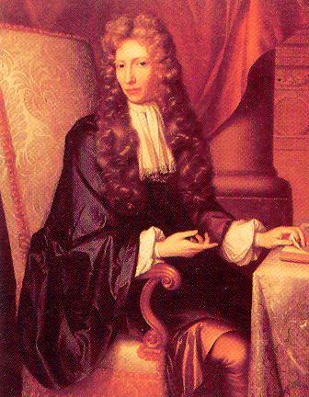
The Skeptical Chemist
In “The Sceptical Chymist”
(1661)
Boyle stated that scientific speculation
was worthless unless it was supported
by experimental evidence.
Robert Boyle
This principle led to the development of the scientific method.
Notes:
Robert Boyle
Published The Sceptical Chymist (1661)
…stated that scientific speculation was worthless unless it was supported by experimental evidence.
This principle led to the development of the scientific method.
ROBERT BOYLE: MIGHTY CHEMIST
Among the many contenders for the title of "Father of Modern Chemistry" is Robert Boyle (January 25, 1627 - December 30, 1691). Boyle was the first prominent scientist to perform controlled experiments and to publish his work with elaborate details concerning procedure, apparatus and observations. He assembled what we would today call a "research group", developed a key piece of apparatus - the vacuum pump, was instrumental in founding the Royal Society, and deserves at least partial credit for the famous gas law which bears his name. Boyle was born in Ireland. As the youngest of fourteen children of the wealthiest man in the British Isles, Boyle's opportunities were almost unlimited. However, while still in adolescence, he chose the pseudonym Philaretus (Lover of Truth) and a life of scientific inquiry seemed almost inevitable. He was educated in the finest possible manner of this day, first studying at Eton and later traveling the Continent with a tutor and his older brother Francis. He learned philosophy, religion, languages, mathematics, and - perhaps most significantly - the new physics of Bacon, Descartes, and Galileo. The physical scientists and their new theories concerning air and vacuum, the movement of planets, and the circulation of blood were to sway his thinking much more than the alchemists.
Boyle published copiously on topics ranging across several fields of science, philosophy, and theology. His first major scientific report, The Spring and Weight of the Air, was published in 1660 and described experiments using a new vacuum pump of his design. Previous pumps, invented by von Guericke (of Magdeburg hemisphere fame), required the strenuous efforts of two men and provided dubious results. Boyle's pump could be operated easily and efficiently by one man. With it Boyle demonstrated that the sound of a bell in the receiver (a thirty quart vacuum chamber) faded as the air was removed, proving that air was necessary for the transmission of sound. In further experiments, he also proved that air was necessary for life and for a candle flame. Boyle felt that his experiments confirmed a mechanical view of nature as opposed to the Aristotelian, non-empirical approach to science. Today we are so accustomed to empirical science that we have difficulty understanding how one could attempt scientific work using only logic. Boyle's empiricism established him as a founder of the modern scientific method and his arguments were so persuasive as to win many important converts, most notably Isaac Newton.
The second edition of The Spring and Weight of the Air, published in 1662, contained the pressure - volume inverse relationship which is familiar to every chemistry student as Boyle's Law. In performing the experiments which led to this generalization, Boyle used mercury in a J-tube and made measurements of the volume of the trapped gas at pressures both higher and lower than normal atmospheric pressure. There is some controversy in naming the relationship after Boyle since much of the work was actually performed by his assistant Robert Hooke, however, the experimental concept originated with Boyle. Furthermore, Boyle was dedicated to the idea of experimental proof of theories while Hooke felt that theories should appeal to reason.
Boyle's best known contribution to scientific knowledge is the 1661 publication of The Sceptical Chymist in which he discusses the idea of an element. Aristotelian science held that elements were not just the simplest of all substances but were also necessary ingredients of all bodies, i.e., if water is an element then all bodies must contain at least a small amount of water. Boyle's idea of an element was somewhat vague and certainly not "modern" in the 20th century sense. But he presented persuasive experimental evidence that most of the commonly accepted elements (fire, water, salt, mercury, etc) did not meet both of the Aristotelian criteria.
In The Sceptical Chymist , Boyle makes a clear break with the alchemists' tradition of secrecy with his conviction and insistence on publishing in great experimental detail. It is noteworthy that Boyle was among the first to publish the details of his work, including unsuccessful experiments, but Boyle was never able to abandon the beliefs of alchemy. He believed in transmutation of the elements and in 1676, he reported to the Royal Society on his attempts to change quicksilver into gold. He believed that he was near success in this endeavor.
In 1654, Boyle had joined a small group of the most influential English scientists, mathematicians, philosophers and physicians who had been meeting weekly in London and in Oxford since 1645. In 1662 the group was chartered as the Royal Society which exists today as the oldest continuous scientific society in the world. The motto of this prestigious organization, "Nullius in Verba" means "nothing in words", i.e., all science should be experimentally based. In 1680, Robert Boyle was elected president of the Royal Society, but declined the honor because the required oath violated his religious principles.
The first use of the term "chemical analysis" is attributed to Boyle who used it in the same sense that we understand it today. He performed assays on gold and silver, tested for copper with ammonia, tested for salt in water with silver nitrate, and devised a thirty item test for mineral water analysis. In addition, he observed that all acids turned a particular vegetable indicator from blue to red and all alkalis turned the indicator green. He found that some substances did not change the color of the indicator and concluded that these were neutral. He thus provided an operational method of classifying substances.
Boyle never married and from the age of 41 lived with his sister Katherine, Lady Ranelagh. He was a shy man with deep religious convictions. He had been a pious youth spending some years in the care of the village parson, Mr. W. Douch. Then at the age of 13, during a violent thunderstorm, he experienced a religious conversion not unlike that of St. Paul. Although an ardent defender of the Anglican Church, he was tolerant of the religious views of others and in later years became particularly sympathetic to the Dissenters. He was offered a position in the clergy but felt a stronger commitment to science. He saw no conflict between the two. He wrote widely on religious themes and gave financial support to his his friend Edward Pococke to translate the New Testament into Malayan. He left a large portion of his considerable estate to charitable organizations.
Robert Boyle died in London on December 30, 1691. He was buried in the Church of Saint-Martin-in-the-Fields next to his sister. Later the church was demolished and no record was made as to where his remains were moved.
Typically, Robert Boyle is remembered solely for Boyle's Law. It is clear that he contributed much more to the development of modern chemical thought. Robert Boyle has been deservedly called "a Mighty Chemist".
Bibliography
Dictionary of Scientific Biography, Charles Coulston Gillispie, editor-in-chief, NY Scribner, 1970 D. Thorburn Burns, "Robert Boyle (1627-1691): A Foundation Stone of Analytical Chemistry in the British Isles, Part I. Life and Thought", Anal. Proc., 1982, 19, 222 - 233
D. Thorburn Burns, "Robert Boyle (1627-1691): A Foundation Stone of Analytical Chemistry in the British Isles, Part II. Literary Style, Specific Contributions to the Principles and Practice of Analytical Chemical Science", Anal. Proc., 1982, 19,, 288 - 295
Marie Boas Hall, "Robert Boyle", Scientific American, 1967, August, 96 - 102
More, L. T., The Life and Works of the Honourable Robert Boyle, Oxford University Press, London, 1944
http://www.woodrow.org/teachers/chemistry/institutes/1992/Boyle.html

Slide 10
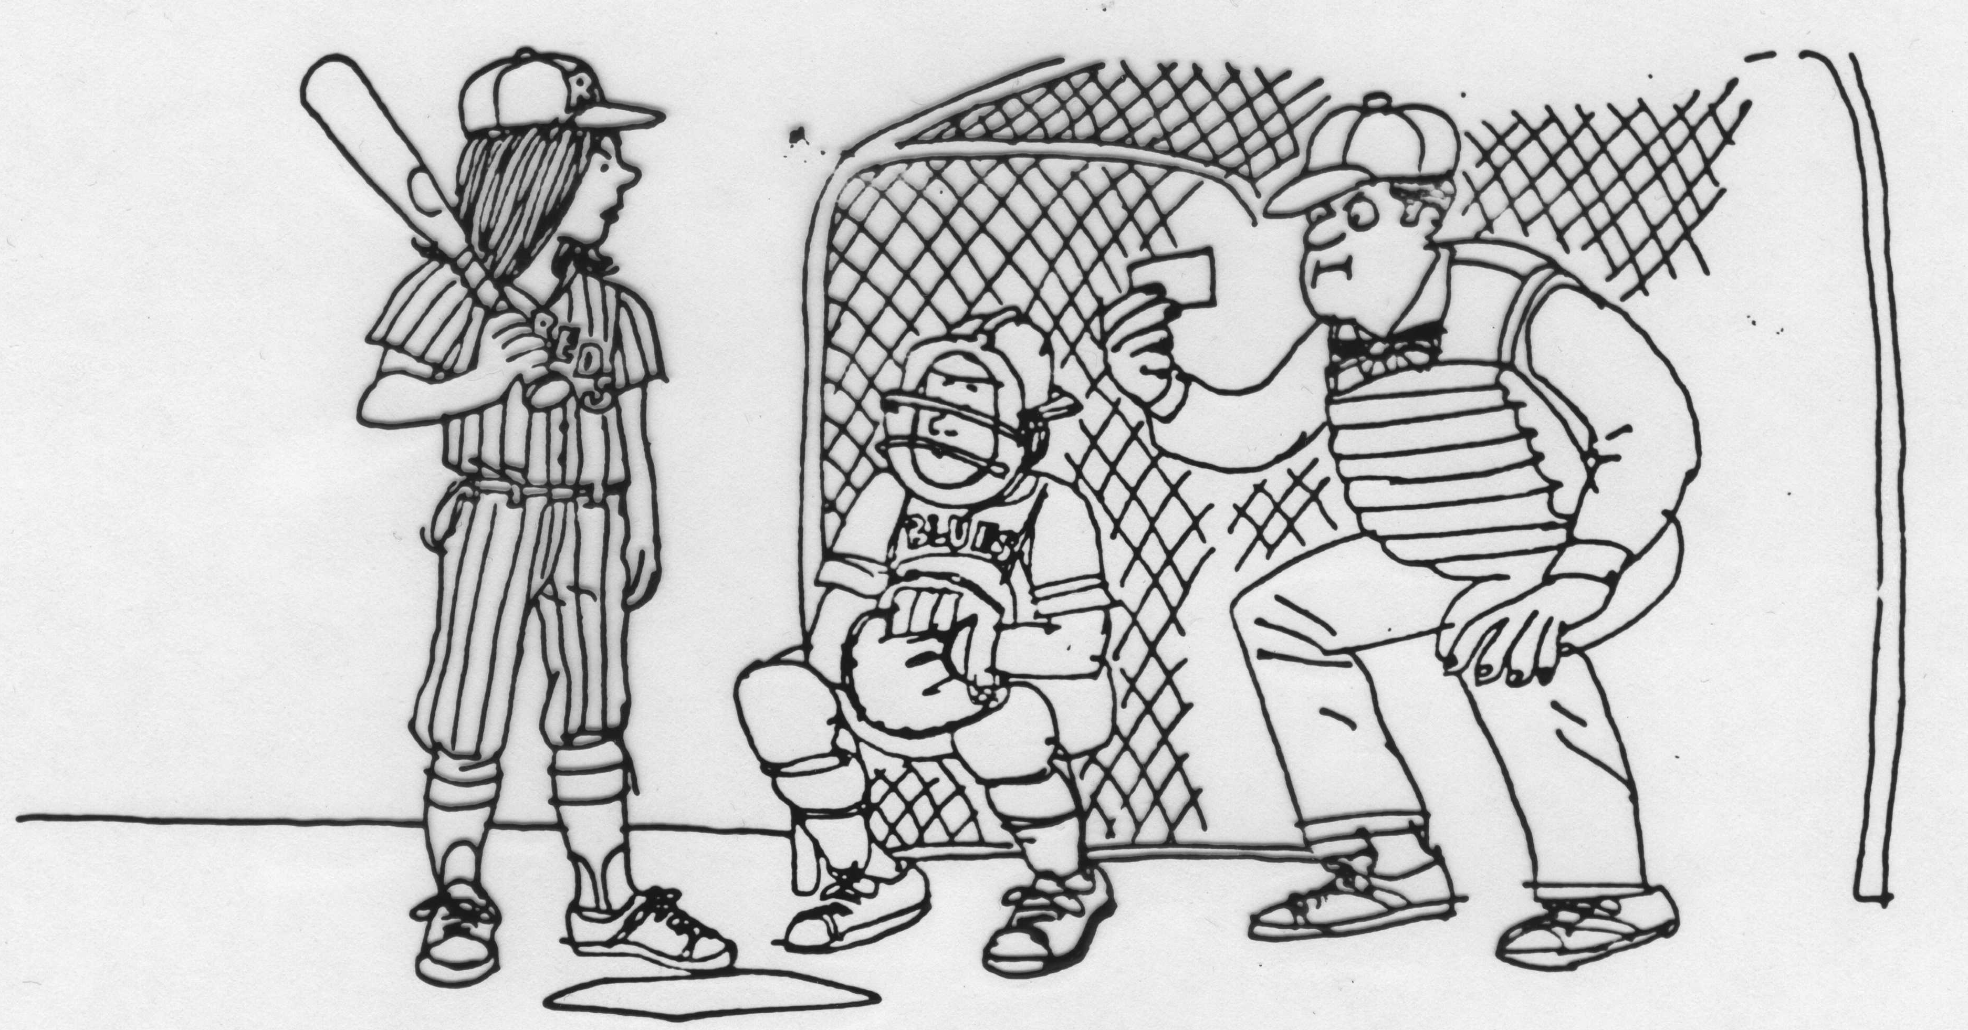
“My mother the eye doctor”
Observation or Inference?
The piece of paper is a note from the mother of the batter.
One player is holding a bat.
The player holding the bat is talking.
One of the teams is called the “Reds.”
One player is a catcher.
Names are written on the uniforms.
The players in the picture are on opposite teams.
The adult is the umpire.
The adult is holding a piece of paper.
The mother of the batter is an optometrist or opthalmologist (an eye doctor).
One player is wearing a catcher’s mask.
Notes:
In performing activities and experiments, you make observations. An observation is something you see.
There are times when you make judgments or decisions based on your observations.
These judgments or decisions are called inferences. Inferences are logical conclusions based on your observations.
Look at the cartoon above.
Read the statement below the cartoon.
Based on what you observe in the cartoon, decide if each statement is an observation or inference.

Slide 11
Data
Observations are also called data.
There are two types of data.
qualitative data quantitative data
descriptions; measurements;
no numbers must have numbers
and UNITS
Notes:
Scientists prefer quantitative data over qualitative data. It is easier to replicate and compare quantitative data.

Slide 12
Parts of the Scientific Method
Identify an unknown.
Make a hypothesis
(a testable prediction).
Experiment to test
the hypothesis.
Draw a valid conclusion.

Slide 13
Scientific Law vs.
Scientific Theory
A law states what happens.
Law of Gravity
A theory tries to explain why
or how something happens.
Theory of Gravity
Atomic Theory
Collision Theory of Reactions
Notes:
You can distinguish between a theory and a law by asking the question: Is the proposal measurable?
Yes, the statement is a law.
No, it is a theory.

Slide 14
Experiments
Law
  – A verbal or mathematical description of a phenomenon that allows for general predictions
  – Describes what happens and not why
  – Unlikely to change greatly over time unless a major experimental error is discovered
Theory
  – Attempts to explain why nature behaves as it does
  – Is incomplete and imperfect, evolving with time to explain new facts as they are discovered
Copyright 2007 Pearson Benjamin Cummings. All rights reserved.

Slide 15
Theory vs. Natural Law
Scientific theory
Natural law
analyze additional data
Hypothesis
analyze initial observations
Experiment

Slide 16
What is Chemistry?
the study of matter
and its changes

Slide 17

How to Succeed in Chemistry
Learn the language
Use the illustrations
Review your notes frequently
Work as many problems as possible
Do NOT cram for exams.

Slide 18
Areas of Chemistry
organic
physical
the study of carbon-
containing
compounds
measuring physical
properties of
substances
e.g., the melting
point of gold
inorganic
everything except
carbon
e.g., compounds
containing metals
biochemistry
the chemistry of
living things

Slide 19
Graphs

Slide 20
Bar Graph
shows how many of something
are in each category

Slide 21
Pie Graph
shows how a whole is broken into parts
Percentage of
Weekly Income

Slide 22
Line Graph
shows continuous change
Stock Price over Time

Slide 23
Elements of a “good” line graph
axes labeled, with units
use the available space
title
neat
Notes:
Hopefully, students will realize this data makes no sense. As temperature increase – the volume of a gas increases.

Slide 24

Basic Concepts in Chemistry

Slide 25
chemical
any substance that takes part in,
or occurs as a result of,
a chemical reaction
All matter can be considered to be
chemicals or mixtures of chemicals.

Slide 26
chemical reaction
a rearrangement of atoms such that
“what you end up with” products
differs from
“what you started with” reactants

Slide 27
Combustion of a Hydrocarbon
carbon
dioxide
methane + oxygen →
+
water
CH₄(g)
+
2
O₂(g)
→
CO₂(g)
+
H₂O(g)
2
→

Slide 28
sodium
hydroxide
sodium
+
water
→
hydrogen
+
2
Na(s)
+
2
H₂O(l)
→
H₂(g)
+
2
NaOH(aq)
→

Slide 29
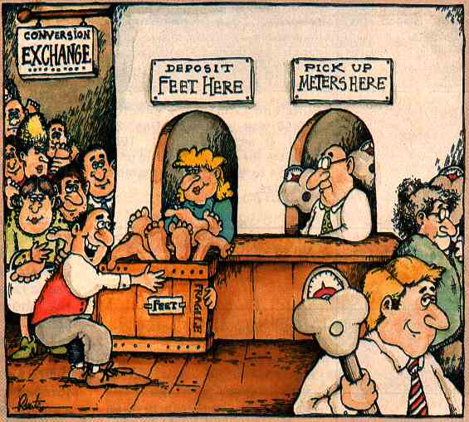
The Metric System
from Industry Week, 1981 November 30
Notes:
http://neatorama.cachefly.net/images/2007-01/metric-system-cartoon.gif

Slide 30

No Cussing!
The following 4-Letter
words are forbidden here:
Inch Mile
Foot Pint
Yard Acre
And we never swear the BIG F (useºC)
Please keep it clean and
Metric

Slide 31
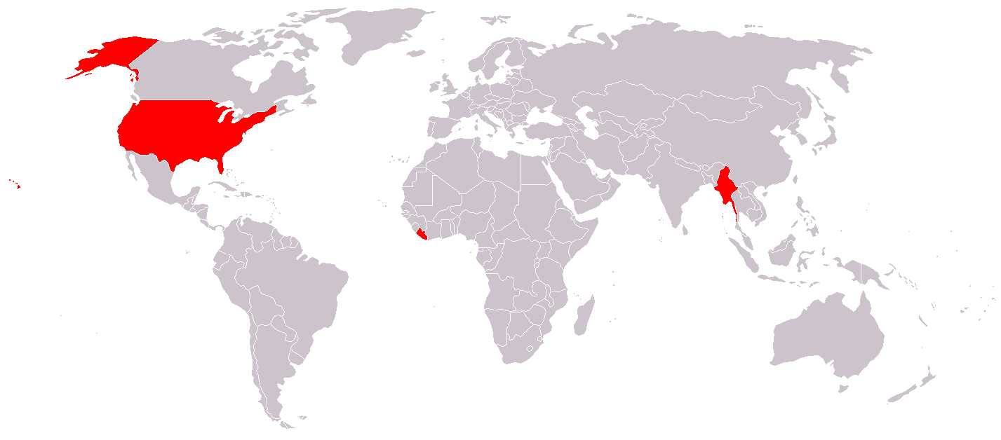
SI System
The International System of Units
Derived Units Commonly Used in Chemistry
Area and Volume: Derived Units
Prefixes in the SI System
Map of the world where red represents countries which do not use the metric system
Notes:
ONLY 3 countries still use the English system of measurement. (England is not one of them!)
Myanmar (Burma), Liberia, and United States of America
http://upload.wikimedia.org/wikipedia/commons/thumb/1/17/Metric_system.png/800px-Metric_system.png

Slide 32
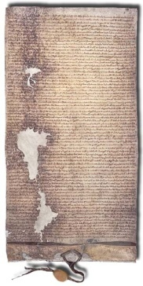
A Common System for Trade
English system of measurement originated in 1215
with the signing of the Magna Carta. It attempted to
bring uniform measurements to world trade.
In 1790, the French government appointed a committee
of scientists to develop a universal measuring system.
It took ~10 years, and they unveiled the Metric system.
length meter m
mass gram g
volume liter L
time second s
Notes:
Note the SI (system international system) differs from the metric system. The base unit for mass in the SI system is kilogram.
SI system adopted in 1954.
1 second = time for 9 192 631 770 oscillations of Cs-133 excitation band radiation
1 meter = distance light travels in 1/299 792 458 of a second
1 kilogram = weight of a standard Pt/Ir cylinder
(US copy in Gaithersburg); (still artifact-based unit)
English translation of the Magna Carta
Henry, by the grace of god, king of England, lord of Ireland, duke of Normandy, Aquitaine and count of Anjou, to the archbishops, bishops, abbots, priors, earls, barons, sheriffs, stewards, servants and to all his bailiffs and faithful subjects who shall look at the present charter, greeting.
Know that we, out of reverence for God and for the salvation of our soul and the souls of our ancestors and successors, for the exaltation of holy church and the reform of our realm have, of our own spontaneous goodwill, given and granted to the archbishops, bishops abbots, priors, earls, barons and all of our realm these liberties written below to be held in our kingdom of England for ever.
(1) In the first place we have granted to God, and by this our present charter confirmed for us and our heirs forever, that the English church shall be free and shall have all its rights undiminished and its liberties unimpaired. We have also granted to all free men of our kingdom, for ourselves and our heirs for ever, all the liberties written below to be had and held by them and their heirs of us and our heirs for ever.(2) If any of our earls or barons or others holding of us in chief by knight service dies, and at this death his heir be of full age and owe relief he shall have his inheritance on payment of the old relief, namely the heir or heirs of an earl £100 for a whole earl's barony, the heir or heirs of a baron £100 for a whole barony, the heir or heirs of a knight 100s, at most, for a whole knight's fee; and he who owes less shall give less according to the ancient usage of fiefs.(3) If, however, the heir of any such be under age, his lord shall not have wardship of him, nor of his land, before he has received his homage; and after being a ward such an heir shall have his inheritance when he comes of age, that is of twenty-one years, without paying relief and without making fine, so however, that if he is made a knight while still under age, the land nevertheless shall remain the wardship of his lords for the full term.(4) The guardian of the land of such an heir who is under age shall take from the land of the heir no more than reasonable revenues,reasonable customary dues and reasonable services, and that without destruction and waste of men and goods; and if we commit the wardship of the land of any such to a sheriff, or to any other who is answerable to us for the revenues of that land, and he destroys or wastes what he has wardship of, we will take compensation from him and the land shall be committed to two lawful and discreet men of that fief, who shall be answerable for the revenues to us or to him to whom we have assigned them; and if we give or sell to anyone the wardship of any such land and he causes destruction or waste therein, he shall lose that wardship and it shall be transferred to two lawful and discreet men of that fief, who shall similarly be answerable to us as is aforesaid.(5) Moreover, so long as he has the wardship of the land, the guardian shall keep in repair the houses, parks, preserves, ponds, mills, and other things pertaining to the land out of the revenues from it; and he shall restore to the heir when he comes of age his land fully stocked with ploughs and all other things in at least the measure he received. All these things shall be observed in the case of wardships of vacant archbishoprics, bishoprics, abbeys, priories, churches and dignities that pertain to us except that wardships of this kind may not be sold.(6) Heirs shall be married without disparagement.(7) A widow shall have her marriage portion and inheritance forthwith and without any difficulty after the death of her husband, nor shall she pay anything to have her dower or her marriage portion or the inheritance which she and her husband held on the day of her husband's death; and she may remain in the chief house of her husband for forty days after his death, within which time her dower shall be assigned to her, unless it has already been assigned to her or unless the house is a castle; and if she leaves the castle, a suitable house shall be immediately provided for her in which she can stay honourably until her dower is assigned to her in accordance with what is aforesaid, and she shall have meanwhile her reasonable estover of common. There shall be assigned to her for her dower a third of all her husband's land which was his in his lifetime, unless a smaller share was given her at the church door. No widow shall be forced to marry so long as she wishes to live without a husband, provided that she gives security not to marry without our consent if she holds of us, or without the consent of her lord if she holds of another.(8) We or our bailiffs will not seize for any debt any land or rent, so long as the available chattels of the debtor are sufficient to repay the debt and the debtor himself is prepared to have it paid therefrom; nor will those who have gone surety for the debtors be distrained so long as the principal debtor is himself able to pay the debt; and if the principal debtor fails to pay the debt, having nothing wherewith to pay it or is able but unwilling to pay, then shall the sureties answer for the debt; and they shall, if they wish, have the lands and rents of the debtor until they are reimbursed for the debt which they have paid for him, unless the principal debtor can show that he has discharged his obligation in the matter to the said sureties.(9) The city of London shall have all its ancient liberties and free customs. Furthermore, we will and grant that all other cities, boroughs and towns, the barons of the Cinque Ports, and all ports shall have all their liberties and free customs.(10) No one shall be compelled to do greater service for a knight's fee or for any other free holding than is due from it.(11) Common pleas shall not follow our court, but shall be held in some fixed place.(12) Recognitions of novel disseisin and of mort d'ancestor shall not be held elsewhere than in the counties to which they relate, and in this manner - we, or, if we should be out of the realm, our chief justiciar, will send justices through each county once a year, who with knights of the counties shall hold the said assizes in the counties and those which cannot on that visit be determined in the county to which they relate by the said justices sent to hold the said assizes shall be determined by them elsewhere on their circuit, and those which cannot be determined by them because of difficulty over certain articles shall be referred to our justices of the bench and determined there.(13) Assizes of darrein presentment shall always be held before the justices of the bench and determined there.(14) A free man shall not be amerced for a trivial offence except in accordance with the degree of the offence and for a grave offence in accordance with its gravity, yet saving his way of living; and a merchant in the same way, saving his means of livelihood; if he has fallen into our mercy: and none of the aforesaid amercements shall be imposed except by the oath of good and law-worthy men of the neighbourhood. Earls and Barons shall not be amerced except by their peers and only in accordance with the degree of the offence. No ecclesiastical person shall be amerced according to the amount of his benefice but in accordance with his lay holding and in accordance with the degree of the offence.(15) No vill or individual shall be compelled to make bridges at river banks, except one who from of old is legally bound to do so.(16) No river bank shall henceforth be made a preserve, except those which were preserves in the time of King Henry, our grandfather, in the same places and for the same periods as they used to be in his day.(17) No sheriff, constable, coroners, or others of our bailiffs shall hold pleas of our crown.(18) If anyone holding a lay fief of us dies and our sheriff or bailiff shows our letters patent of summons for a debt that the deceased owed us, it shall be lawful for our sheriff or bailiff to attach and make a list of chattels of the deceased found upon the lay fief to the value of that debt under the supervision of law-worthy men, provided that none of the chattels shall be removed until the debt which is manifest has been paid to us in full; and the residue shall be left to the executors for carrying out the will of the deceased. And if nothing is owing to us from him, all the chattels shall accrue to the deceased, saving to his wife and his children their reasonable shares.(19) No constable or bailiff shall take the corn or other chattels of anyone who is not of the vill where the castle is situated unless he pays on the spot in cash for them or can delay payment by arrangement with the seller; if the seller is of that vill he shall pay within forty days.(20) No constable shall compel any knight to give money instead of castle-guard if he is not willing to do it himself; and if we lead or send him on military service, he shall be excused guard in respect of the fief for which he did service in the army in proportion to the time that because of us he has been on service. (21) No sheriff, or bailiff of ours or other person shall take anyone's horses or carts for transport work unless he pays for them at the old-established rates, namely at ten pence a day for a cart with two horses and fourteen pence a day for a cart with three horses. No demesne cart of any ecclesiastical person or knight or of any lady shall be taken by the aforesaid bailiffs. Neither we nor our bailiffs nor others will take, for castles or other works of ours, timber which is not ours, except with the agreement of him whose timber it is.(22) We will not hold for more than a year and a day the lands of those convicted of felony, and then the lands shall be handed over to the lords of the fiefs.(23) Henceforth all fish-weirs shall be cleared completely from the Thames and the Medway and throughout all England, except along the sea coast.(24) The writ called Praecipe shall not in future be issued to anyone in respect of any holding whereby a free man may lose his court.(25) Let there be one measure for wine throughout our kingdom, and one measure for ale, and one measure for corn, namely 'the London quarter'; and one width for cloths whether dyed, russet or halberget, namely two ells within the selvedges. Let it be the same with weights as with measures.(26) Nothing shall be given in future for the writ of inquisition by him who seeks an inquisition of life or limb: instead, it shall be granted free of charge and not refused.(27) If anyone holds of us by fee-farm, by socage, or by burgage, and holds land of another by knight service, we will not, by reason of that fee-farm, socage or burgage, have the wardship of his heir or of land of his that is of the fief of the other; nor will we have custody of the fee-farm, socage or burgage, unless such fee-farm owes knight service. We will not have custody of anyone's heir or land which he holds of another by knight service by reason of any petty serjeanty which he holds of us by the service of rendering to us knives or arrows or the like.(28) No bailiff shall in future put anyone to manifest trial or to oath upon his own bare word without reliable witnesses produced for this purpose.(29) No free man shall in future be arrested or imprisoned or disseised of his freehold, liberties or free customs, or outlawed or exiled or victimised in any other way, neither will we attack him or send anyone to attack him, except by the lawful judgement of his peers or by the law of the land. To no one will we sell, to no one will we refuse or delay right of justice.(30) All merchants, unless they have been publicly prohibited beforehand, shall be able to go out of and come into England safely and securely and stay and travel throughout England, as well by land as by water, for buying and selling by the ancient and right customs free from all evil tolls, except in time of war and if they are of the land that is at war with us. And if such are found in our land at the beginning of a war, they shall be attached without injury to their persons or goods, until we, or our chief justiciar, know how merchants of our land are treated who were found in the land at war with us when war broke out; and if ours are safe there, the others shall be safe in our land.(31) If anyone who holds of some escheat such as the honour of Wallingford, Boulogne, Nottingham, Lancaster, or of other escheats which are in our hands and are baronies dies, his heir shall give no other relief and do no other service to us than he would have done to the baron if that had been in the baron's hand; and we will hold it in the same manner in which the baron held it. Nor will we by reason of such a barony or escheat have any escheat held in chief of us elsewhere. (32) No free man shall henceforth give or sell to anyone more of his land than will leave enough for the full service due from the fief to be rendered to the lord of the fief.(33) All patrons of abbeys who have charters of advowson of the kings of England or ancient tenure or possession shall have the custody of them during vacancies, as they ought to have and as is made clear above.(34) No one shall be arrested or imprisoned upon the appeal of a woman for the death of anyone except her husband.(35) No county shall in future be held more often than once a month and where a greater interval has been customary let it be greater. Nor shall any sheriff or bailiff make his tourn through the hundred save twice a year (and then only in the due and accustomed place), that is to say, once after Easter and again after Michaelmas. And view of frankpledge shall be held then at the Michaelmas term without interference, that is to say, so that each has his liberties which he had and was accustomed to have in the time of King Henry our grandfather or which he has since acquired. View of frankpledge shall be held in this manner, namely, that our peace be kept, that a thing be kept full as it used to be, and that the sheriff shall not look for opportunities for exactions but be satisfied with what a sheriff used to get from holding his view in the time of King Henry our grandfather.(36) It shall not in future be lawful for anyone to give land of his to any religious house in such a way that he gets it back again as a tenant of that house. Nor shall it be lawful for any religious house to receive anyone's land to hand it back to him as a tenant. And if in future anyone does give land of his in this way to any religious house and he is convicted of it, his gift shall be utterly quashed and the land shall be forfeit to the lord of the fief concerned.(37) Scutage shall be taken in future as it used to be taken in the time of King Henry our grandfather. And let there be saved to archbishops, bishops, abbots, priors, Templars, Hospitallers, earls, barons and all other persons, ecclesiastical and secular, the liberties and free customs they had previously. All these aforesaid customs and liberties which we have granted to be observed in our kingdom as far as it pertains to us towards our men, all of our kingdom, clerks as well as laymen, shall observe as far as it pertains to them towards their men. In return for this grant and gift of these liberties and of the other liberties contained in our charter on the liberties of the forest, the archbishops, bishops, abbots, priors, earls, barons, knights, freeholders and all of our realm have given us a fifteenth part of all their movables. We have also granted to them for us and our heirs that neither we nor our heirs will procure anything whereby the liberties contained in this charter shall be infringed or weakened; and if anything contrary to this procured from anyone, it shall avail nothing and be held for nought, these being witness: the Lord S archbishop of Canterbury, E of London, J of Bath, P of Winchester, H of Lincoln, R of Salisbury, B of Rochester, W of Worcester, J of Ely, H of Hereford, R of Chichester, and W of Exeter, bishops; the abbot of St Albans, the abbot of Bury St Edmunds, the abbot of Battle, the abbot of St Augustine's Canterbury, the abbot of Evesham, the abbot of Westminster, the abbot of Peterborough, the abbot of Reading, the abbot of Abingdon, the abbot of Malmesbury, the abbot of Winchcombe, the abbot of Hyde, the abbot of Chertsey, the abbot of Sherborne, the abbot of Cerne, the abbot of Abbotsbury, the abbot of Milton, the abbot of Selby, the abbot of Whitby, the abbot of Cirencester, H de Burgh the justiciar, R earl of Chester and Lincoln, W earl of Salisbury, W earl of Warenne, G de Clare earl of Gloucester and Hertford, W de Ferrers earl of Derby, W de Mandeville earl of Essex, H le Bigod earl of Norfolk, W count of Aumale, H earl of Hereford, John the constable of Chester, Robert de Ros, Robert fitz Walter, Robert de Vipont, William Brewer, Richard de Munfichet, Peter fitz Herbert, Matthew fitz Herbert, William de Aubeney, Robert Grelley, Reginald de Braose, John of Monmouth, John fitz Alan, Hugh de Mortimer, Walter de Beauchamp, William of St John, Peter de Maulay, Brian de Lisle, Thomas of Moulton, Richard de Argentein, Geoffrey de Neville, William Mauduit, John de Balun. Given at Westminster on the eleventh day of February in the ninth year of our reign.
Translation from English Historical Documents 1189-1327, ed. H Rothwell, Eyre & Spottiswoode, London, 1975 (pp. 341-6), reproduced by courtesy of Taylor & Francis

Slide 33
The International System of Units
Quantity Name Symbol
Length meter m
Mass kilogram kg
Time second s
Amount of substance mole mol
Thermodynamic temperature Kelvin K
Electric current amperes amps
Luminous intensity candela cd
Dorin, Demmin, Gabel, Chemistry The Study of Matter , 3rd Edition, 1990, page 16
Notes:
Internet Access to the National Institute of Standards and Technology
“To be or not to be”: the English or the Metric system
The English system of measurement used today in the United States originated in the decrees of English monarchs. The French Revolution produced the overthrow of the French monarchy and in 1799 it also led to the creation of the set of weights and measures we call the metric system. The metric system was legalized for use in the United States in 1866 along with the traditional English system. Today the only countries in the world that do not use the metric system are the United States of America, Liberia and Myanamar.
United States government policy toward the Metric System
This part is to access the following URLs for the National Institute of Standards and Technology, NIST, and review the evolution of the relationship between the United States and the Metric System. You can answer the first question after reviewing this NIST page.
http://ts.nist.gov/ts/htdocs/200/202/ic1136a.htm
What was the year when the United States signed the “Treaty of the Meter”?
Access this FDA page to answer the following question.
http://www.fds.goc/ora/inspect_ref/itg30.html
What does the term “Both timeless and toothless” have to do with the Metric Conversions Act of 1975? In your opinion does this influence the pace of metrification in the United States?
Name ____________________ Hr ____
Internet Access to the National Institute of Standards and Technology
“To be or not to be”: the English or the Metric system
Another part of your assignment is to write a brief argument on the back of this page for adopting the metric system and replacing the English system. Lastly you are to write an argument for continuing the current pattern of using two systems.
Argument for adopting the Metric system and dropping the English system.
Argument for retaining both the English system and the Metric system

Slide 34
Prefixes in the SI System
The Commonly Used Prefixes in the SI System
Power of 10 for
Prefix Symbol Meaning Scientific Notation
_______________________________________________________________________
mega- M 1,000,000 10⁶
kilo- k 1,000 10³
deci- d 0.1 10⁻¹
centi- c 0.01 10⁻²
milli- m 0.001 10⁻³
micro- μ 0.000001 10⁻⁶
nano- n 0.000000001 10⁻⁹
Zumdahl, Zumdahl, DeCoste, World of Chemistry 2002, page 118

